Slide 1
Arrests in New York City
Presented by: Faith Dempsey, Kaitlyn Beck, Brittany Foster,
Anil Shinde, Sai Nadella

Slide 2

Issue
Which demographic has the greatest number of arrests and for what crime in New York City?
Notes:
Sai

Slide 3
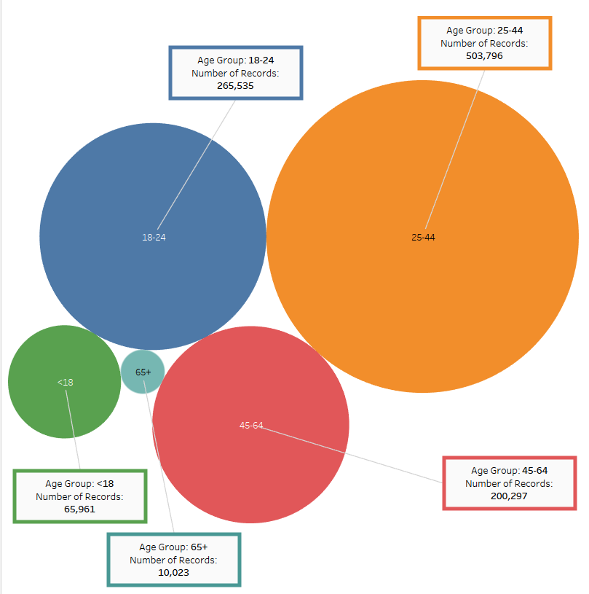
Age group 25-44
Count: 503,796
Age Groups
Of
Individuals Arrested

Slide 4
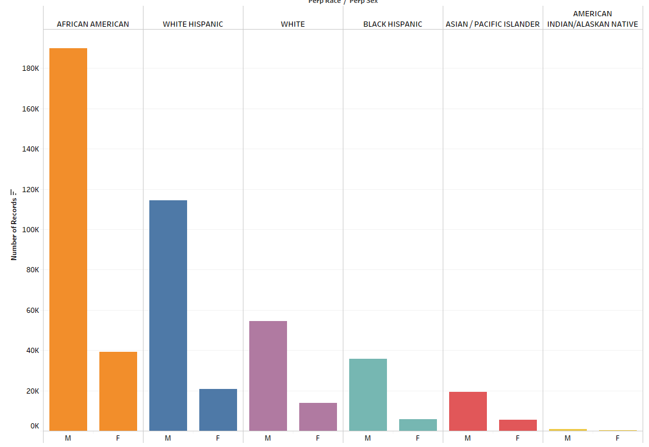
Age group 25-44
African American
Male
Count: 189,944
Race & Sex
of
Individuals Arrested

Slide 5
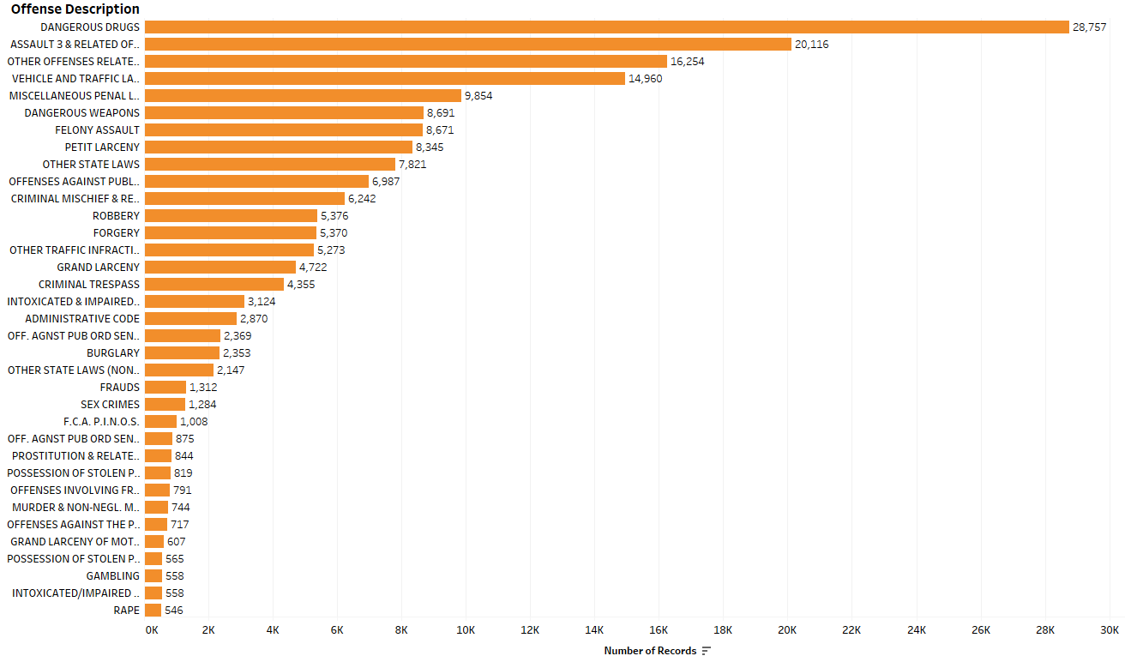
Age group 25-44
African American
Male
Dangerous Drugs
Count: 28,757
Descriptions
of
Crimes Committed

Slide 6
Conclusion
The demographics of African American males age 25-44 have the greatest number of arrests for committing the crime of “Dangerous Drugs” between the years 2014 and 2017 in NYC.

Slide 7
Questions?

